Slide 1
Boot Process/Services
Team or presenters name
Date: 26/05/2020
Location: DUB

Slide 2




Virtual Housekeeping
Use
Headsets
Go on
Mute
Participate Actively
Minimize Distractions
Notes:
***Please ensure you have your headset plugged in so we can avoid echoing and maintain audio quality
***Throughout the session, please keep your mic on mute to avoid background noise during the presentation portions.
***Please be aware you will be asked to participate and engage throughout the session. We ask that you are fully active in the chat box, and are also ready to be called on and unmute if needed. We’ll also have you click on some links to view videos, participate in polls and at some point during the session, we’ll be sending you to specific break out rooms depending on which service you’ll be shadowing.
***Lastly, we ask that you’re fully present. Keeping engaged is even more difficult in a virtual setting, so make sure you turn off notifications, maybe set an out of office in your email. Minimize distractions

Slide 3
Course objectives
elements of the boot process
configuration and troubleshooting
Managing services with systemd/SysVinit

Slide 4
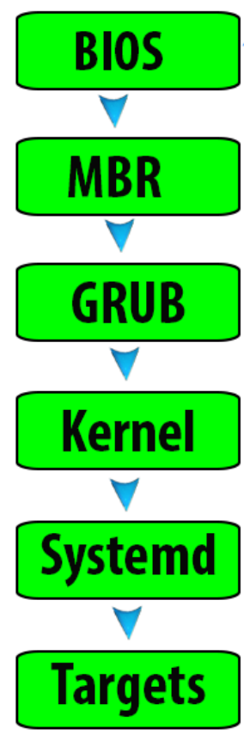
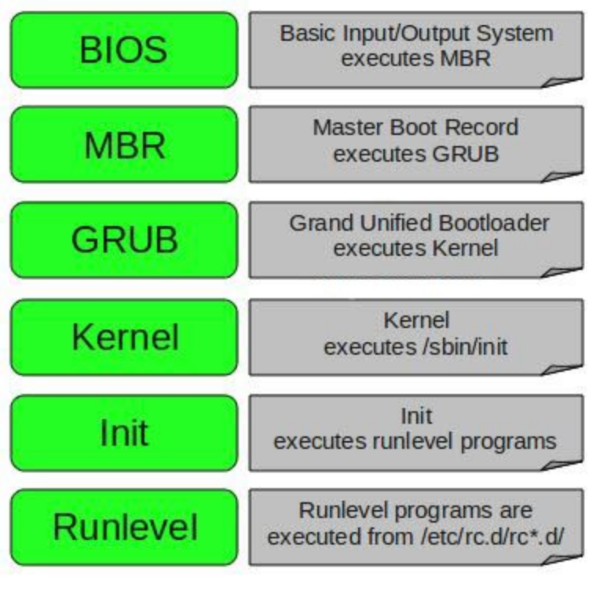
elements of the boot process
Notes:
the boot process is split into six different stages
on the left is the boot process for SysVinit, on the right for systemd based systems
stages 5/6 will differ depending on if you have a SysVinit system like Red Hat 5 or a systemd system like Red Hat 7
the first stage is the BIOS or also UEFI nowadays that is the basic input out system loaded from the EEPROM of the motherboard
The Bios then executes the MBR, which can also be a GPT these days.
The MBR/GPT lives at the start of the boot device
This is also referred to as the first stage of GRUB
GRUB is the boot loader, which will have information on the kernel, initramfs and root file system
the configuration lives in /boot/grub*
this can be GRUB or most often these days GRUB2
the kernel gets loader by the bootloader and is in the end responsible for starting the first process, which is init or systemd
targets or runlevels do determine what is the desired state of the operating system that it gets booted to.
Commonly used is runlevel3, which corresponds to the multiuser target
Let’s go into the details now
there are some other version of this, like the upstart system or a different bootloader than GRUB, but they are the rare exception and will be briefly covered later

Slide 5
BIOS / UEFI (firmware)
Types:
BIOS
EFI
UEFI
How do I know?
/sys/firmware/efi
Dmesg output
check the motherboard manual
Notes:
BIOS- Basic Input Output System – An old, very limited way of doing things. Bios runs 16 bit code. Whereas most modern computers run 32/64 bit Operating systems. BIOS Runs code from the first sector on disk . This boot sector in turn runs additional code.
EFI – Extensible Firmware Interface – EFI boots by loading programs (.efi) files from a partition on hard disk known as the EFI System Partition or ESP. These boot loaders programs can then take advantage of other available services like reading files from the hard disk.
UEFI – Unified Extensible Firmware Interface – Essentially just EFI 2.x
There are a number of ways to try an tell which one you’ve used to boot however these are all diagnostic, but the absence of the signs of a EFI boot does not mean that you have booted in BIOS. (if the sign is there its definite, if its not there, its inconclusive)
Indicators of a EFI or UEFI boot include:
The presence of /sys/firmware/efi after boot. However this directory can be absent in some distros/circumstances.
Dmesg output can refer to EFI.
Windows partition table – if its GPT you booted in EFI mode. And if its MBR you booted in BIOS mode.

Slide 6
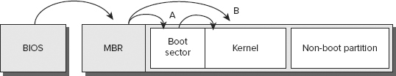
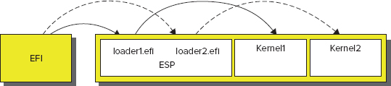
Bios/UEFI details
Bios Boot process can be complicated.
But it basically does one of two things.
Find a bootable partition,
execute the boot sector,
hand over to a secondary boot loader.
Locate an OS Kernel,
Load it,
Execute it directly
EFI Firmware is much more sophisticated.
/boot/efi
efibootmgr

Slide 7
MBR/GPT
First disk sector(512 bytes)
440/446 first bytes are bootstrap
Grub stage1
Partition table
Signature 55 aa
Grub stage1.5 pointer
First disk sector(protective MBR)
uses 34 LBAs of 512 byte sector size
bootstrap and partitions separated
up to 256 partitions (GRUB2)
GPT stores data redundant
Perform CRC check of partition table
partition size up to 2^64 blocks
max ~2TB partition size
max 4 primary partitions
$ sudo gdisk -l /dev/xvda
MBR: protective
GPT: present
Notes:
both are a standard for the layout of partition tables of a physical computer storage device
MBR is the master boot record and GPT, which again stands for GUID (globally unique identifiers) partition table
MBR again is like the BIOS from the early 80s and is used mostly in conjunction with the BIOS
GPT is the newer standard which added many capabilities and introduced changes to the boot process as well as how partition table information is stored
GPT is supported on all modern operating systems across the board, including Linux/Windows and MacOs
With Linux, you can boot MBR/GPT disk with either BIOS or UEFI.
MBR uses the first sector of the disk, which is traditionally 512 bytes.
The bootstrap code, which is stage 1 of GRUB is stored in the first 440/446 bytes, depending on the MBR implementation
After that the partition table is present and a signature offset of 55aa in hex, which indicates the MBR
There can be a pointer to GRUB stage 1.5 if present. Otherwise it moves to stage 2 which is located in the /boot folder
MBR has a maximum of 4 primary partitions, which you can work around with extended or nested partitions.
It’s a hack frequently used in the past
Your boot partition cannot exceed 2TB in size.
GPT features a protective MBR, which allow a BIOS, which is unaware of GPT to boot from this disk as well
GPT is much larger with 34 logical block addressing units each of 512 bytes sector size
Therefor bootstrap information and partitions are in separate sectors
Supports up to 256 partitions, which is a GRUB2 limitation, not a GPT limitation
Stores data redundantly in different sectors of the disk, making it more rebust
Partition size exceeds maximum known disk size by far in 2020.
How to check which one I use?
gdisk –l <disk>

Slide 8
boot loaders / boot managers
Grub config file
/boot/grub2/grub.cfg
/etc/grub.d
/etc/default/grub
Rebuilding the config file
update-grub
grub2-mkconfig -o /boot/grub2/grub.cfg
grub2-mkconfig -o /boot/efi/EFI/<OS>/grub.cfg
Loadable modules
Support for conditional logic
Some examples:
GRUB(2)
Syslinux
LILO
Notes:
A note on the difference between boot managers and boot loaders. The terms bootmanager/loader are often used interchangeably. But in practice and by definition, a boot loader loads a kernel into memory and transfers control to the kernel. A boot manager presents a menu of boot options. Many programs such as grub combine both functions into one program/application. This is why it is sometimes unclear.
Just as there are many operating different flavours of operating systems, there are lots of different bootloaders. Here’s a list of some of the ones used with Unix operating systems.
1). The one we’ll be focusing on today and the one which is most prominent by far is GRUB (or Grand Unified Bootloader).
GRUB comes pre packaged as the default bootloader with most user friendly linux distributions. It is also the most feature rich of the bootloaders and its configuration files are similar to “sh” scripting language.
2). Syslinux is a smaller much more specialized family of bootloaders. Non-necessary information-(It’s currently limited to loading files from the partition where it is installed)
4). LILO – Linux Loader is a legacy multi-boot loader for Linux systems, has been phased out in favour of easier-to-use bootloaders like GRUB.
GRUB2 is designed to work with BIOS and EFI based computers as well as some other firmware types. GRUB2 on bios based systems will almost always install correctly, however on EFI systems there can be issues.
WHY?
Grub config file - /boot/grub/grub.cfg contains information about each of the boot images that grub can choose from an the options associated with them.
So now that you know where the grub config file is, forget about it, in practice on newer operating systems you shouldn’t be editing it. GRUB 2 makes a changed here, in that it employs a set of scripts and other tools that help automatically maintain the /boot/grub/grub.cfg file. he intent is that system administrators need never explicitly edit this file. Instead, you would edit files in /etc/grub.d, and the /etc/default/grub file, to change your GRUB 2 configuration.
After making such changes, you must explicitly rebuild the grub.cfg file .
A distribution that’s designed to use GRUB 2, such as Ubuntu, will automatically run the configuration scripts after certain actions, such as installing a new kernel with the distribution’s package manager. If you need to make changes yourself, you can type update-grub or grub-mkconfig > /boot/grub/grub.cfgA distribution that’s designed to use GRUB 2, such as Ubuntu, will automatically run the configuration scripts after certain actions, such as installing a new kernel with the distribution’s package manager. If you need to make changes yourself, you can type update-grub or grub-mkconfig > /boot/grub/grub.cfg . This command re-reads these configuration files and writes a fresh /boot/grub/grub.cfg file.
GRUB2 Enabled Loadable modules for specific modes of operation.
It also enabled specific support for conditional logic. This meant that you could make loading specific modules/ displaying certain boot options, dependent on whether certain conditions had been met.

Slide 9
kernel
the boot loader will load the kernel and initramfs into memory
these are specified in the config file of the boot loader
initramfs/initrd are used to load additional modules
executes first process which has a PID of 1
init or systemd then spawns further processes depending on the runlevel
dmesg or /var/log/messages or /var/log/syslog will show information
Notes:
The boot loader will load the kernel and into memory, which are specified in the configuration file of the boot loader
When the kernel is loaded into memory by GRUB2, it first initializes and configures the computer's memory and configures the various hardware attached to the system, including all processors, I/O subsystems, and storage devices.
The kernel then extracts initramfs into a tmpfs that’s mounted in memory and then uses this to mount the root filesystem as read-only (to protect it in case things don’t go well during the rest of the boot process).
After mounting the root filesystem, the system manager is the first program/daemon to be executed and thus will have a PID of 1. In a SysV system, this daemon is called “init” and SystemD systems, this daemon is systemd.
init or systemd then spawns further processes depending on the runlevel
dmesg or /var/log/messages or /var/log/syslog will show information
(show dmesg live)
so what’s a runlevel?

Slide 10
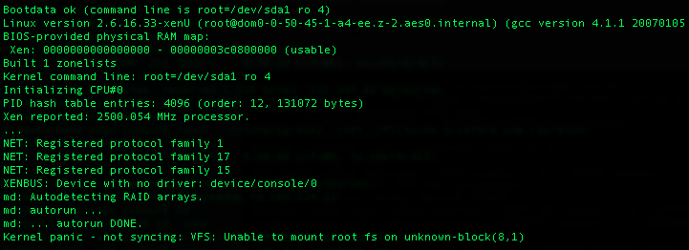
dmesg example / failed boot
Notes:
This is a very old school example. Let’s try to extract as much information out of this as possible to determine the root cause
Ask the students to look at the output and try determine:
- Why the boot failed – Unable to mount the root FS for some reason, is a good enough answer
Identifying what version the kernel - 2.6.16.33-xenU . This is version 2.6.16.33 with build xenU.
GCC version 4.1.1 20070105 with which the kernel was built/compiled.
Whether it’s a user supplied AMI or an Amazon Linux one
Its an Amazon AMI.
Useless Trivia Amazon EC2 used to be called Amazon execution service. Hence AES (aes0.internal) in the second line.

Slide 11
runlevels/targets
0 – Transitional - shutdown
1 – single user mode.
2 – On debian a full multi-user mode with X running and a graphical login.
3 – On RHEL/Fedora full multi-user mode. Non graphical login
4 – Usually undefined by default. Customizable
5 – On RHEL/Fedora same as 3, with XDM graphical login.
6 – Used to reboot the system.
runlevel0.target, poweroff.target
runlevel1.target, rescue.target
runlevel2.target, multi-user.target
runlevel3.target, multi-user.target
runlevel4.target, multi-user.target
runlevel5.target, graphical.target
runlevel6.target, reboot.target
Notes:
SysVinit systems do use runlevels and systemd uses targets. While they all have corresponding values or numbers to each other, they work in different ways which we will explore.
Let’s first focus on the individual runlevels and the corresponding targets
Linux relies on runlevels to determine what features are available. Runlevels are numbered from 0 to 6, and each one is assigned a set of services that should be active. Upon booting, Linux enters a predetermined runlevel, which you can set. Knowing what these functions are, and how to manage runlevels, is important if you’re to control the Linux boot process and ongoing operations.
RunLevel Functions:
- 0 A transitional runlevel, meaning that it’s used to shift the computer from one state to another. Specifically, it shuts down the system. On modern hardware, the computer should completely power down. If not, you’re expected to either reboot the computer manually or power it off.
- 1 Single-user mode. What services, if any, are started at this runlevel varies by distribution. It’s typically used for low-level system maintenance that may be impaired by normal system operation, such as resizing partitions.
- 2 On Debian and its derivatives, a full multi-user mode with X running and a graphical login. Most other distributions leave this runlevel undefined.
- 3 On Fedora, Mandriva, Red Hat, and most other distributions, a full multi-user mode with a console (non-graphical) login screen.
- 4 Usually undefined by default and therefore available for customization.
- 5 On Fedora, Mandriva, Red Hat, and most other distributions, the same behavior as runlevel 3 with the addition of having X run with an XDM (graphical) login.
- 6 Used to reboot the system. This runlevel is also a transitional runlevel. Your system is completely shut down, and then the computer reboots automatically.
At the bottom you can see the corresponding targets.
They can be called by their number (runlevel0) or their name (poweroff)
targets 2 and 4 are normally not used in favour of 3

Slide 12
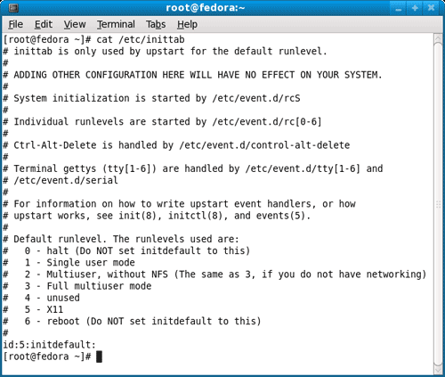
manage runlevels/targets
action
runlevels
targets
get current
get default
change default
change current
runlevel
/etc/inittab/
/etc/inittab
init <runlevel>
runlevel (!)
systemctl get-default
systemctl set-default ?.target
systemctl isolate ?.target
ls -l /usr/lib/systemd/system/default.target
/usr/lib/systemd/system/default.target -> graphical.target
Notes:
Here we can see the main actions we can perform with runlevels and targets.
To get the current runlevel, we are using “runlevel” on both systems. There is currently no systemd variant of this command
For changing and reading the default, the configuration file /etc/inittab is used in SysVinit
The systemctl command is the equivalent in systemd
Some commands are backwards compatible, for example a “init 6” on a systemd system will still reboot the machine
Behind the scenes, on the left is the configuration file example for the inittab
On the right is the symbolic link for the default target, which is used in the background when querying or setting the default
In the folder /usr/lib/systemd/system are all the targets listed

Slide 13
SysVinit and systemd
Both are init systems / system managers
Systemd used in all new distros (RH 7+,AL2,Ubuntu16)
Systemd backwards compatible
Systemd works with service files instead of scripts
Systemd is faster during boot and (somewhat) easier to manage
Notes:
Talk about SysVinit and system together with the main differences
Briefly mention upstart

Slide 14

SysVinit
service httpd start/stop/restart/reload/status
Chkconfig httpd on/off/--list
Works with runlevels (/etc/inittab)
Services have soft links in /etc/rc.d/rc.<runlevel>.d/…
They start with S (start) or K (kill) and the order number
Notes:
Do demo of commands and show directories for config
The /etc/init.d/rc or /etc/rc.d/rc script performs the crucial task of running all the scripts associated with the runlevel.
The runlevel-specific scripts are stored in /etc/rc.d/rc?.d, /etc/init.d/rc?.d, /etc/rc?.d, or a similar location. (The precise location varies between distributions.)
In all these cases, ? is the runlevel number. When entering a runlevel, rc passes the start parameter to all the scripts with names that begin with a capital S and passes the stop parameter to all the scripts with names that begin with a capital K.
These SysV startup scripts start or stop services depending on the parameter they’re passed, so the naming of the scripts controls whether they’re started or stopped when a runlevel is entered. These scripts are also numbered, as in S10network and K35smb.

Slide 15

systemd
Systemctl /start/stop/restart/reload/status/enable/disable httpd2
Works with targets instead of runlevels
Systemctl get-default/set-default/isolate
Journalctl (backwards compatible to /var/log folder)
Service files in /lib/system/system
Notes:
Mention that action/service order is in reverse in contrast to SysVinit (chkconfig vs systemctl)
more about journalctl and logging in upcoming module

Slide 16
unit files
[Unit]
Description=The Apache HTTP Server
Wants=httpd-init.service
After=network.target remote-fs.target nss-lookup.target httpd-init.service
Documentation=man:httpd.service(8)
[Service]
Type=notify
ExecStart=/usr/sbin/httpd $OPTIONS -DFOREGROUND
ExecReload=/usr/sbin/httpd $OPTIONS -k graceful
[Install]
WantedBy=multi-user.target
Notes:
There are many types of unit files for different purposes like .service, .device or .timer
This is an example of the unit file type .service for httpd
By default, preinstalled unit files are located in /lib/systemd/system
For custom unit files /etc/systemd/system is recommended
Description is the comment field of the unit
Wants declares that this unit would like to start another unit of type service if possible, weaker than “requires”
After specifies which unit have to be successfully loaded in order for this one to start
Documentation is the man page file
service type notify= it is expected that the service sends a notification message via sd_notify(3) or an equivalent call when it has finished starting up.
exec start and reload determine what does get executes when calling systemctl start/reload
wantedby specifies that this unit file will only get executed when the multi-user target is specified as the desired boot target
This is only an example, and systemd unit files are very versatile but do require some reading when you’re only used to bash scripts for startup from SysVinit

Slide 17
modify initramfs/initrd
Temporary root file system
Used to mount actual root file system
Modules can be listed and added/removed to initramfs/initrd
Config File: /etc/dracut.conf
List Modules: # lsinitrd /boot/initramfs-$(uname -r).img
Rebuild: # dracut –f /boot/initramfs-$(uname -r).img $(uname -r)
Add Modules: # dracut –f --add-drivers "kmodule1 kmodule2"
Remove modules: # dracut --omit-drivers "kmodule1 kmodule2”
Alternatively,modify the add_dracutmodules/omit_dracutmodules directives in /etc/dracut.conf
Notes:
In computing (specifically as regards Linux computing), initrd (initial ramdisk) is a scheme for loading a temporary root file system into memory, which may be used as part of the Linux startup process. initrd and initramfs refer to two different methods of achieving this.
Both are commonly used to make preparations before the real root file system can be mounted.
You can add modules for specific hardware drivers into the initramfs or initrd, that will be available at a very early stage during boot
Common examples are storage drivers or network drivers.

Slide 18
/etc/fstab
UUID=933deb5a-af4b-437b-82e6-2b449da297c5 / xfs defaults,noatime 1 1
”nofail” which does not fail the boot if unable to mount
“mount –a” mount everything in fstab, good way to check config
field 1 can be device name, label or UUID (recommended)
$ sudo blkid
/dev/xvda1: LABEL="/" UUID="933deb5a-af4b-437b-82e6-2b449da297c5"
Notes:
/etc/fstab will save the configuration for all devices that will get mounted at boot time
{already did this in session 4 so just for reference. No need to go over this. More for boot failure troubleshooting]
This field describes the block special device or remote filesystem to be mounted.
This field describes the mount point (target) for the filesystem.
This field describes the type of the filesystem. Linux supports many filesystem types: ext4,xfs, f2fs, tmpfs, sysfs, proc, iso9660, udf, squashfs etc
This field describes the mount options associated with the filesystem. If this option is set for a file system in /etc/fstab, then reading accesses will no longer cause the atime information (last access time) that is associated with a file to be updated
This field is used by dump(8) to determine which filesystems need to be dumped. Defaults to zero (don't dump) if not present. Not used anymore
This field is used by fsck(8) to determine the order in which filesystem checks are done at boot time. The root filesystem should be specified with a fs_passno of 1. Other filesystems should have a fs_passno of 2. Filesystems within a drive will be checked sequentially, but filesystems on different drives will be checked at the same time to utilize parallelism available in the hardware. Defaults to zero (don't fsck) if not present.

Slide 19
troubleshooting tools
dmesg
/var/log/messages or /var/log/syslog or app log
change to prior boot option in GRUB
check fstab for ”dead” entries or wrong formatting
check for changes and ask the customer
systemctl status <service>
Notes:
1) dmesg for getting boot information
2) messages and syslog for same reason
3) for any boot issues within the GRUB phase, try to change the default option
4) fstab entries often an issue, also with detached EBS volumes or NFS connection issues
5) check when it worked the last time and find out what changed, sometimes the customer will tell you

Slide 20
You should now be familiar with…
elements of the boot process
configuration and troubleshooting
Managing services with systemd/SysVinit

Slide 21
time for practice
inspect dmesg to get an overview of the boot process
make httpd/apache start on runlevel 3/5
inspect grub config file and /boot directory
troubleshoot ami-059249de4d960b859 (eu-west-1)
troubleshoot ami-07c3ece0676a55281 (eu-west-1)
Notes:
solutions to AMIs….scroll down
initramfs corrupt on first AMI, need to remount EBS and install new initramfs via dracut or restore from similar AMI
typo in fstab on second ami, need to remounts EBS to correct this, mount –a to use in the future.

Slide 22
Insist on the highest standards
Please take 2 minutes to complete the survey to let us know what you liked about the training and what can be improved.
This will help us to continue creating helpful and relevant training content.
Link is in the invitation email.

